Slide 1
Kubernetes
Security
Notes:
1

Slide 2



Secure Kubernetes
API
Kubectl

Slide 3
Authentication - Who can access?
Files – Username and Passwords
Files – Username and Tokens
Certificates
External Authentication providers - LDAP
Service Accounts

Slide 4
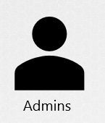

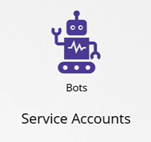







Authentication

Slide 5
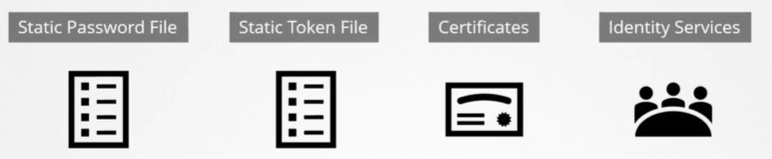
Authentication Mechanisms

Slide 6

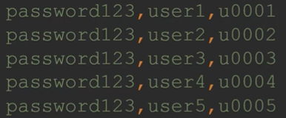
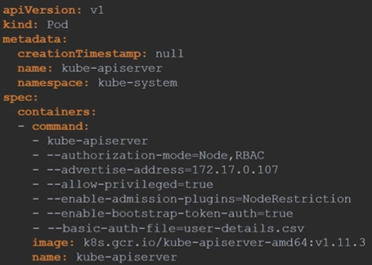
Authentication – Basic Auth

Slide 7
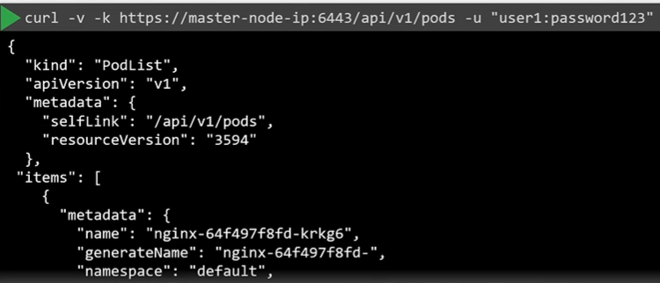
Authentication – Basic Auth

Slide 8



Authentication – Basic Auth

Slide 9
Authentication – Basic Auth

Slide 10
Authentication with API
Notes:
10

Slide 11

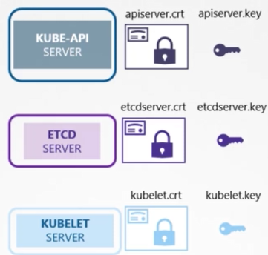
Authentication – TLS Certificates

Slide 12
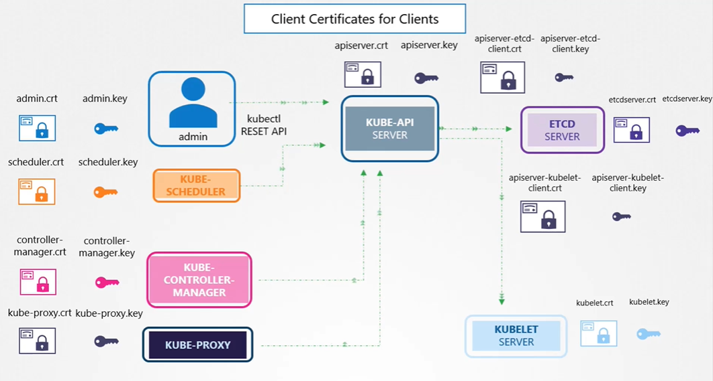
Authentication – TLS Certificates

Slide 13
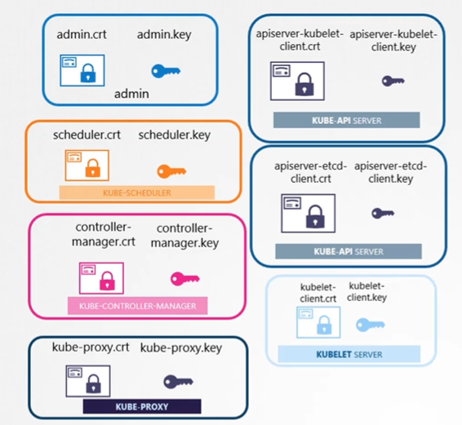

Authentication – TLS Certificates

Slide 14




Certificate Authority (CA)

Slide 15

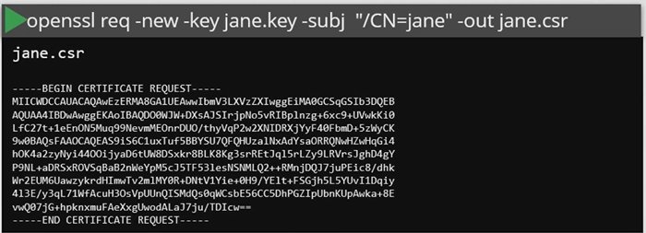
Certificate Authority (CA)

Slide 16

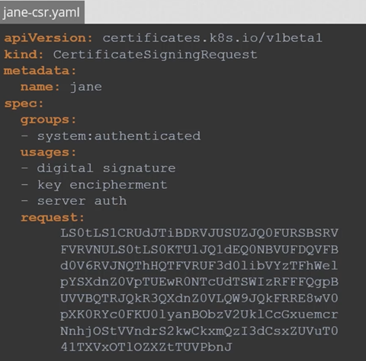


Certificate Authority (CA)

Slide 17

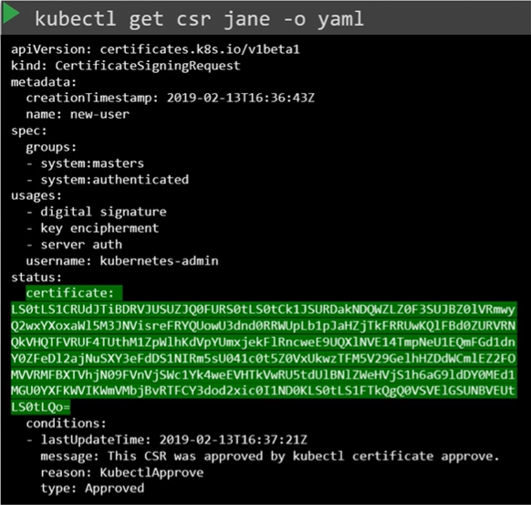
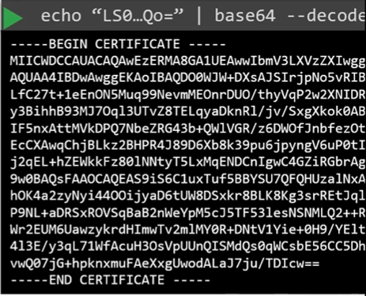
Certificate Authority (CA)

Slide 18
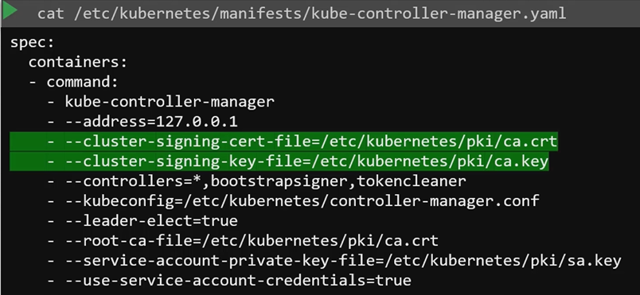
Certificate Authority (CA)

Slide 19
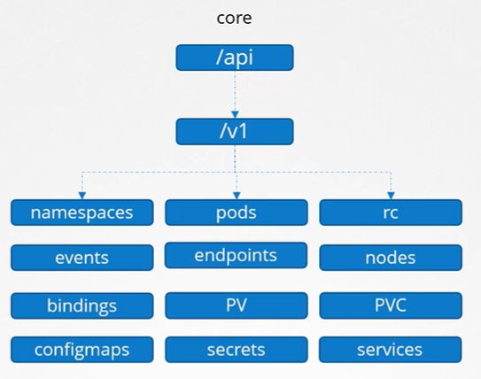
API Groups

Slide 20
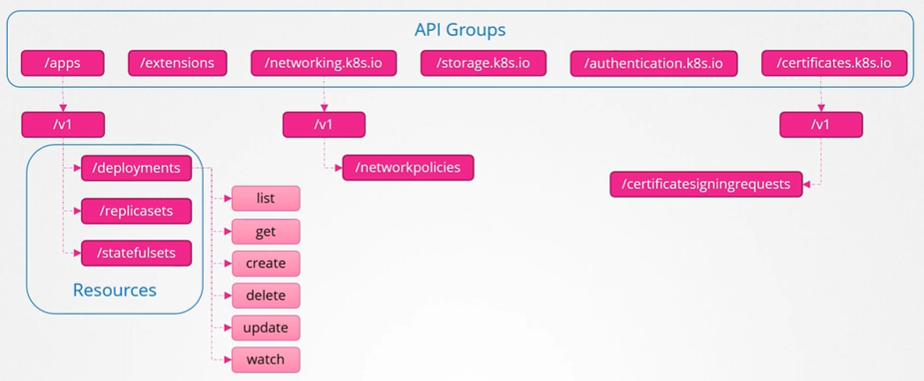
API Groups

Slide 21
Role-Based Access Control
Security design that restricts access to valuable resources based on the role the user holds
RBAC model in Kubernetes is based on three elements:
Roles: definition of the permissions for each Kubernetes resource type
Subjects: users (human or machine users) or groups of users
RoleBindings: definition of what Subjects have which Roles
Notes:
21

Slide 22
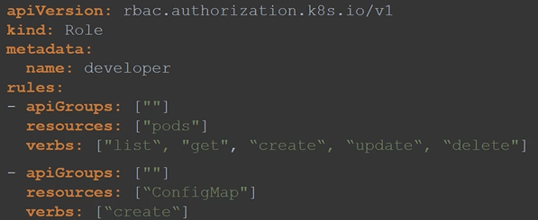
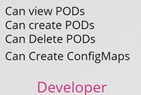
Role-Based Access Control
Roles
Notes:
22

Slide 23
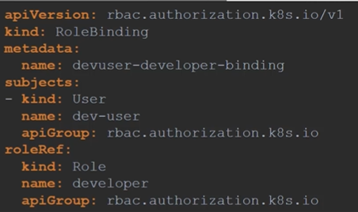

Role-Based Access Control
Roles Binding
Notes:
23

Slide 24
Verify Access
kubectl auth can-i create deployments
kubectl auth can-i delete services
kubectl auth can-i delete nodes --as dave

Slide 25
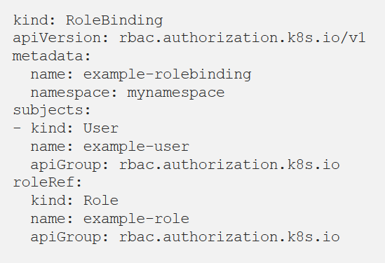
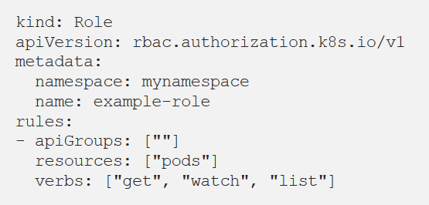
Roles, Subjects, RoleBindings
Notes:
25

Slide 26


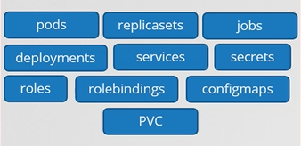
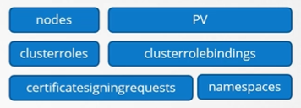
Namespaced v/s clustered resources
Notes:
26

Slide 27
ClusterRoles and ClusterRoleBindings
ClusterRoles and ClusterRoleBindings which are useful in the following cases:
Give permissions for non-namespaced resources like nodes
Give permissions for resources in all the namespaces of a cluster
Give permissions for non-resource endpoints like /healthz
Notes:
27

Slide 28
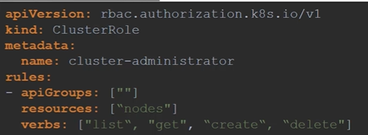
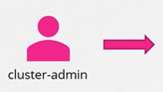
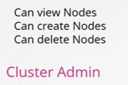
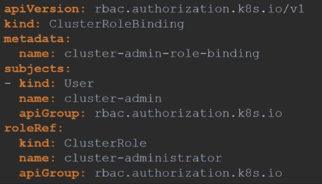
Cluster Role and ClusterRoleBinding

Slide 29
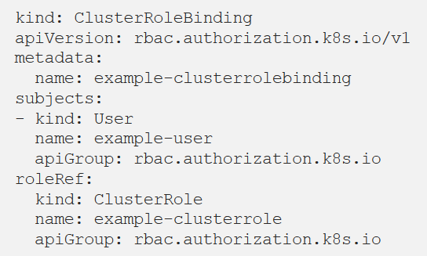
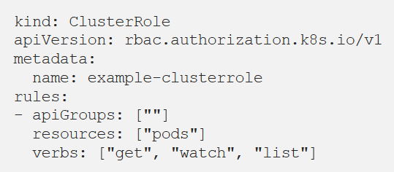
Roles, Subjects, RoleBindings
Notes:
29

Slide 30
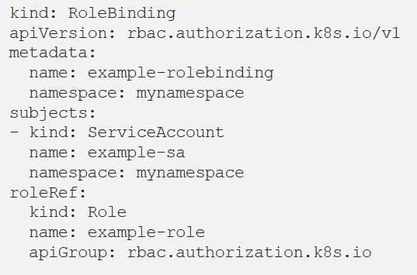


Bind Subject to Role or ClusterRole
Notes:
30

Slide 31
Certificate Management
kubeadm alpha certs check-expiration
Automatic certificate renewal
Manual certificate renewal - kubeadm alpha certs renew

